Slide 1
How to get there?
Day 1

Slide 2
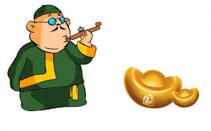
第三步：汉字练习
Activity 3: Practice Target Characters with the Use of Pictures

Slide 3
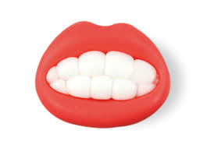
口
Step A:
Look at the picture and see if you can recognize the radical or character.

Slide 4
讠

Slide 5
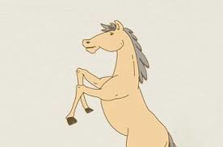
马

Slide 6
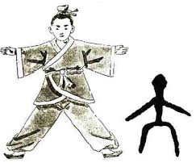
大

Slide 7
几

Slide 8
艹

Slide 9
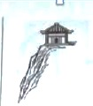
广 guǎng

Slide 10
火

Slide 11
足

Slide 12
日

Slide 13
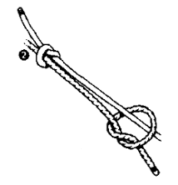
带
dài

Slide 14
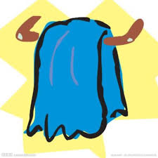
巾
jīn

Slide 15
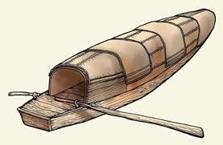
舟 zhōu

Slide 16
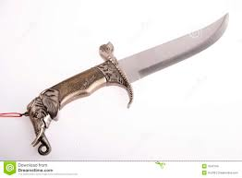
匕
bǐ

Slide 17
心
忄

Slide 18
目

Slide 19
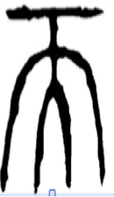
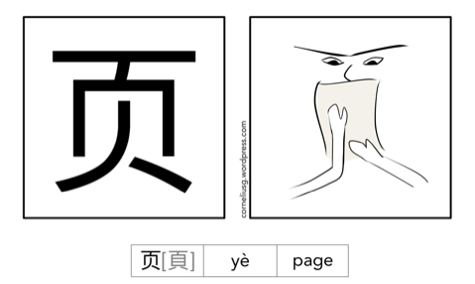

Slide 20
又

Slide 21
Step B:
Please encode the different graphs to a character.
Pay additional attention to the configuration of the character.
船
chuán

Slide 22
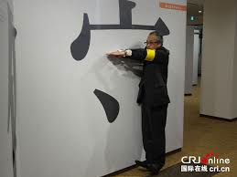
讨
tǎo
守

Slide 23
讨
tǎo
寸

Slide 24
坐
zuò

Slide 25
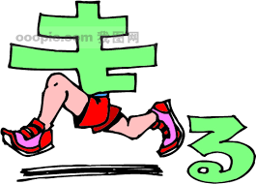
走
zǒu

Slide 26
古
gǔ
做
Notes:
古，常常是作为汉字的一部分，比如做事情的做。

Slide 27
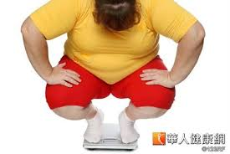
董
dǒng

Slide 28
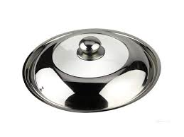
带
dài

Slide 29
慢
màn

Slide 30
路
lù

Slide 31
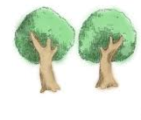
麻
má
a general term for hemp, flax, jute, etc

Slide 32
烦
fán

Slide 33
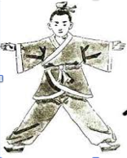
骑
qí

Slide 34
论
lùn

Slide 35
Review 复习
Step C:
Please encode the different graphs to a character.
Pay additional attention to the configuration of the character.

Slide 36
Notes:
Formative Assessment

Slide 37
Compositional Encoding 复习
Step D:
Combine and encode multiple pictures to words or phrases.

Slide 38
骑马

Slide 39
坐船

Slide 40
古董

Slide 41
走路

Slide 42
讨论=tǎo lùn

